Slide 1
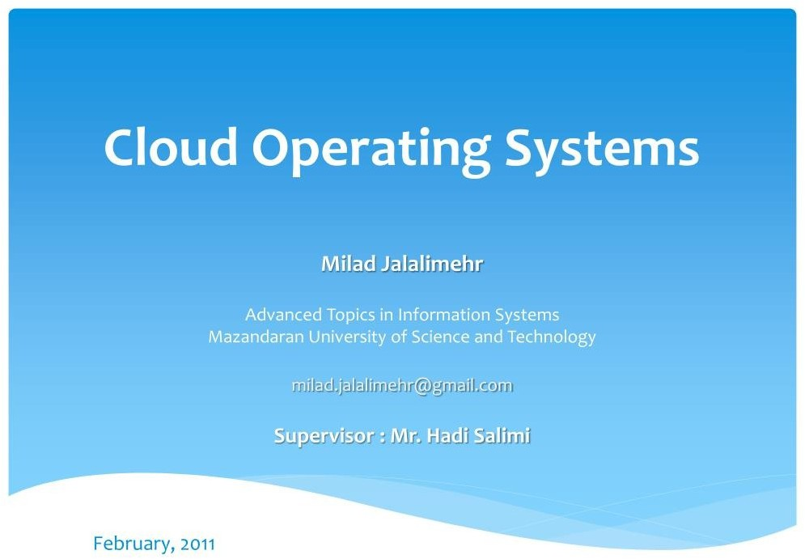

Slide 2

* Introduction
Definitions
Cloud Operating Systems
  Paradigm
  Architecture
Challenges
* Current Cloud Operating Systems (Samples)
Conclusion
References
Milad Jalalimehr - Operating System for Clouds
2 / 18
Mazandaran University of Science and Technology (MUSf)

Slide 3

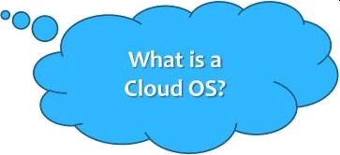
Definitions:
  Distributed System (DS)
  Cloud
Milad Jalalimehr - Operating System for Clouds
§ / 18
Mazandaran University of Science and Technology (MUSf)

Slide 4

* Proceedin use ofcomputingservices.
Clouds have the potential to provide novel compute capacity to the average user.
Also provides more facilities for IT professionals.
Milad Jalalimehr - Operating System for Clouds
Mazandaran University of Science and Technology (MUSf)
4 / 18

Slide 5
In order for the user to effectively control all of this computational power, We need an operating system for these new hardware platforms.
Milad Jalalimehr - Operating System for Clouds
Mazandaran University of Science and Technology (MUSf)
§ / 18

Slide 6


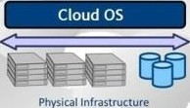
A simple definition:
Cloud Interface
The Cloud OS manages a number of servers and hardware devices, Giving the users the impression that they are interacting with a single infinite capacity and elastic cloud.
ASrct e
ect
Infrastructure services for virtualization, storage and networking
Milad Jalalimehr - Operating System for Clouds
Mazandaran University of Science and Technology (MUST)
6 / 1g

Slide 7


Paradigm used in Cloud Operating System:
Object
Thread
Object-Thread Model
.\'\iIad .!a|a|imchr Opera-ine, System for Clouds
.\Jnza nc!nrnn UniveFsit y of Science anc! Tecl*nolo y (MUST)

Slide 8

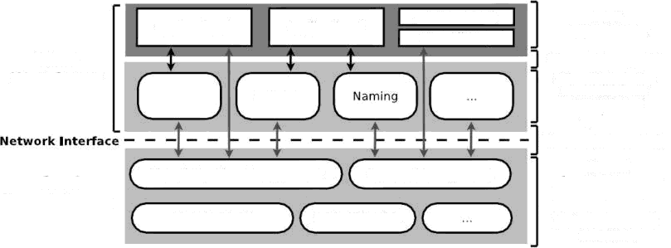
Application C User Library
User Appllcatio»s
Cloud Library API
Cloud Libraries a standard set of distr|buted
systems
Cloud system Calls
Application A
Application B
Cloud
User Space
Replication
Storage
Virtual Machine Management
Process Nanagement
Kernel
Cloud Processes provide cloud-wide
resource abstract‹ons
and management
interfaces
Cloud
Kernel Space
Measurement
Authentication
Milad Jalalimehr — Operating System for Clouds Mazandaran University of Science and Technology (MUST)
8/ 8

Slide 9

Cloud computing common challenges system. Such as:
* Scalability
infrastructure presents many with respect to the operating
Elasticity of Demand
Faults
Milad Jalalimehr - Operating System for Clouds Mazandaran University of Science and Technology (MUSf)
9 / 1@

Slide 10

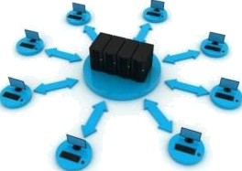
The number of computers being added by cloud computing providers has been growing at a vast rate, driven largely by user demand for hosted computing platforms.
* Cloud OS's need to embrace scalability and make it a first order design constraint.
Milad Jalalimehr - Operating System for Clouds
1 0 1@
Mazandaran University of Science and Technology (MUST)

Slide 11

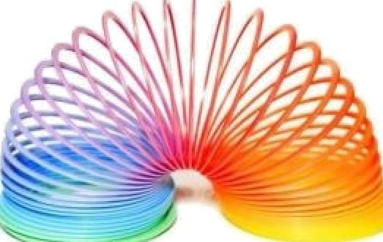
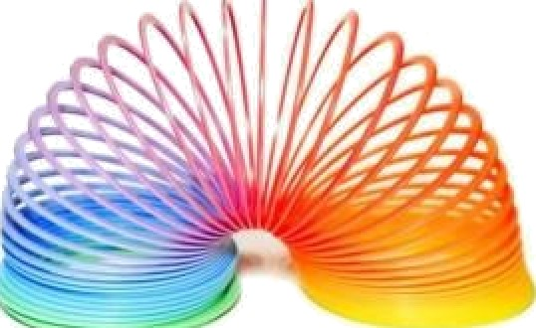
A major commonality between clouds is that the demand is not static.
Furthermore, the variability of demand is much higher than in previous systems and the amount of available resources can be varied over a much broader range.
Milad Jalalimehr - Operating System for Clouds
11 / 1@
Mazandaran University of Science and Technology (MUST)

Slide 12

Cloud applications usually share cloud resources with other users and applications in the cloud.
The likelihood of software faults in clouds are high, Due to the inherent difficulty of writing multithreaded applications.
Milad Jalalimehr - Operating System for Clouds
12 / 1B
Mazandaran University of Science and Technology (MUSf)

Slide 13
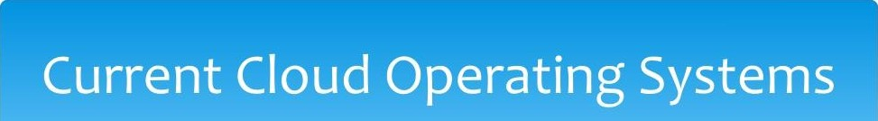
Available Cloud Operating Systems:
  VMware vsphere 4
  Ubuntu Enterprise OS
And Web-Based Cloud Operating Systems
Milad Jalalimehr - Operating System for Clouds
13/18
Mazandaran University of Science and Technology (MUSf)

Slide 14
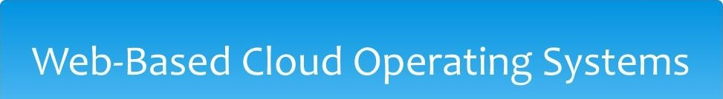
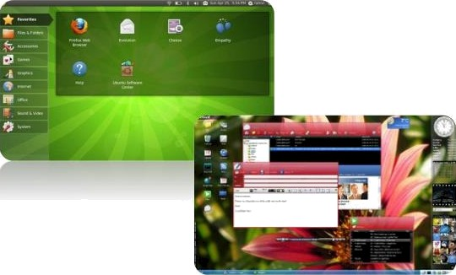
iCloud
eyeOS Glide OS g.ho.st
Milad Jalalimehr - Operating System for Clouds
*4/18
Mazandaran University of Science and Technology (MUSf)

Slide 15

Design goals and chief design features:
Support {or object-thread computational model
< Network-trnnspnrent obJect invocation
  Pecistent storage Sharing vin o*iects Automatic load balancing
Milad JaJalimahr - Operating System for Clouds
15/18
Mazaridaran University of Science and Technology (yUST}

Slide 16





t1] F.Pianxe, P.Bosch, A.Duminuco, N.Janssens, T.Stathopou Toward a Cloud Operating
s, . ener,
System," Network Operations and Management Symposium Workshops (NOMS Wksps}, 2010.
[2{ I. Foster, C. Kesselman, J. M. Nick, and 5. Tuecke, “The physiology of the grid: An open grid services architecture for distributed systems integratian,” in Open Grid Servica infrastructure WG, Global Grfd Forum, zooz.
f3] "Amazon ECz.” [Online] kttp://aws.amazon.com/ecz.
[4] D. Nurmi, R. Wolski,1 Grzegorczyk, G. Oberte\\l, 5. Soman, L Youseff, and D. Zagorodnov, “The eucalyptus open-source cloud-computing system," in Proc. of Ctoud Computing and Its Applications,
Oct. y008.
F Ch
J. Dean, S. Ghemawat, W. C. Hsleh, D. A. Wallach, M. Burrows, T. Chandra, A. Fikes, and R.
E.
gtable: A distributed storage system for structured data,' in 7th USENIX Symposium on
Operating Systems Design and Implementation (OSDI\ 2006.
[6] S. J. Mallender, G. van Rossum, A. S. Tanenbaum, 8. van Renesse, and H. van Staveren, "Amoeba: A
distributed operating system for the ‹ggos,” IEEE Computer, vol. 23, no. $, PP
44 53• *99
[y] E. V. Hensbergen, N. P. Evans, and P. 5tanley-Marbell, "A unified execution model for cloud cO Mting,” in In Proc. of the Ord ACM SIGOFS International Workshop on Large Scale Distributed Systems and Middleware (LADIS), zooq.
Milad JaJalimahr - Operating System for Clouds
z6 /18
Mazaridaran University of Science and Technology (yUST}

Slide 17







Maximlllen, A. Ranabahu, R. Engehausen, and L C. Anderson, "Toward cloud-agnostic mlddlewares," in Proceedings of OOPSLA ’og, (New York, NY, USA), ]0{2. 61§—626, ACM, Hoog.
[g] E. K. Lua, J. Crowctoft, M. Pias, R. Sharma, and S. Lim, “A survey and comparison of peer-to-peer overlap network schemes,” IEEE Communications Survey and Tutorial, vol 7› pp. z›—93a March 2OOz[. t1O] SETI@Home. [Online] http://setJathome.berkeley.adu.
UI] C. F0x, D. Gannon, S.-H. Ko, S. Lee, S. PalllcLara, M. Plerce, X. Alu, X. Rao, A. Uyar, M. Wang, and W.
Wu, Peer-to-Peer GAds. John Wiley and Sons Ltd, 2 3
t12] I. Foster and A. lamnitchi, “On death, es, and t convergence a peer-to-peer and grid
cömputlng,” in In and International Workshop on Peer-to-Peer Systems (IPTPS), pp. 1i8—128, zooy.
I1§] N. Drost, R. van l’diGtsW] OOft and H. Bal, “Simpte locality-aware coallocation in peer-to-peer
supercomputlng,” in Proceedings@ the 6th IEEE/ACM cCGrid Symposium, zoo6.
t1§/ J. Ritter, “Why gnutella can't scale. No, rea\ly.“ [Onfine] http://www.darkrïdge.com/ jpr$/doc/gnuteIla.html., Feb zoom.
t1$] J. Albrecht, R. Braud, D. Dao, N. Topllsld, C. TutHe, A.1 Snoeren, and A. vahdat,"Remote Control: Distributed Application Configuration, Management, and Yisuallzation with Plush,” in Proceedings of the Twenty-fimt USENIX USA Conferenca, November z0o7
Milad JaJalimahr - Operating System for Clouds Mazaridarän University of Science and Technology (yUST}

Slide 18
